Slide 1
Cultural humility and working across cultures: Lessons from first- and second-generation immigrants
Dr. Hellmuth Weich

Slide 2
Setting the stall
ADP and language
Our theoretical base
Cultural humility
Some lessons learnt from first- and second-generation immigrants:
Language
Acculturation
Families, problem solving and parenting
How would we practice different and what knowledges should we give our students, ASYE’s and apprentices?

Slide 3
But before we start
This is not a presentation, it needs to be a conversation.

Slide 4
Health warning:
Some ideas are radical and may offend.

Slide 5
Language 1. Language of ADP 2. Language as oppression 3. Language when coming to the UK

Slide 6
LANGUAGE
http://www.youtube.com/watch?v=_1Vn9OwDjgQ&feature=fvst
FOR MANY STUDENTS, LANGUAGE IS COMPLICATED, ESPECIALLY IF IT IS YOUR 2ND 3RD OF EVEN 4TH
MEANING OF WORDS

Slide 7
Thinking about your students
What is their first language?
What language do they speak at home?
What language do they try to formulate ideas in?
So when I'm with family, we tend to speak a mixture of English, Ndebele and Shona because we do have people in the family will also speak Shona. So one sentence can have 3 languages which is normally very difficult for somebody outside to understand, but we don't do that consciously. It's just something that happens automatically where you just integrate all three languages anyway.
It's interesting just how you live your language, how you’re… you express things in, in, in your own language. I think that's one of the things I realized that sometimes I can. I can say something, but there's just no English translation for it. Uh, and there's certain words that and certain phrases, that no matter what you do, you can't translate them.

Slide 8
Sotho and Tswana words for feelings vs English
Lim (2016) acknowledges cultural constraints on expression of emotions. Literature tends to analyse the collectivist and individualist cultures. Markus and Kitayama (1991) analysed the responses of the Western culture and deemed it to be individualist, where people are encouraged to be individual and freely express emotions. On the other hand, people from Eastern cultures tend to adopt the collectivist approach with great emphasis on group harmony. Emotions are not expressed freely in such a culture but are modified to avoid a negative influence or response.
Non-verbal communication
Difficult to translate feelings. Some languages express feelings via metaphors, music etc. These are difficult to translate.

Slide 9
WHAT THE BRITISH SAY | WHAT THE BRITISH MEAN | WHAT FOREIGNERS UNDERSTAND
I hear what you say | I disagree and do not want to discuss it further | He accepts my point of view
With the greatest respect | You are an idiot | He is listening to me
That's not bad | That's good | That's poor
That is a very brave proposal | You are insane | He thinks I have courage
Quite good | A bit disappointing | Quite good
I would suggest | Do it or be prepared to justify yourself | Think about the idea, but do what you like
Oh, incidentally/ by the way | The primary purpose of our discussion is | That is not very important
I was a bit disappointed that | I am annoyed that | It doesn't really matter
Very interesting | That is clearly nonsense | They are impressed
I'll bear it in mind | I've forgotten it already | They will probably do it
I'm sure it's my fault | It's your fault | Why do they think it was their fault?
You must come for dinner | It's not an invitation, I'm just being polite | I will get an invitation soon
I almost agree | I don't agree at all | He's not far from agreement
I only have a few minor comments | Please rewrite completely | He has found a few typos
Could we consider some other options | I don't like your idea | They have not yet decided
Think about these when giving feedback to some of your students

Slide 10
Most interpreters in UK are ad hoc and have no formal training in mental Health, increasing the risk of no formal training in psychiatric terms. To make sense of the information given by a psychotic patient, they may paraphrase, summarise or make an attempt to interpret meaning which changes the information altogether.
Translating mental health terms

Slide 11
Where should the emphasis be?
We will all agree that:
Language matters
Language has been used to marginalise and oppress
Language creates barriers
Language is the first step to turning people into non-human objects (Mark Neary)
Language reflects our values
But ….

Slide 12
WHERE SHOULD THE EMPHASIS BE?
Language is central to advocacy and empowerment. But have we tipped the scales away from social action to social talking and not direct action, things that people can see and experience?
The emphasis on language allows us to hide behind language. It allows students to say, I used the right language, I was so aware of the issues of discrimination, without saying what they have done about it. What has actually changed for the people? SBW
There is no emphasis in the social work curriculum, SWE standards, the PCF, etc. on community engagement and community action. Our emphasis is more on writing good reports. Good reports only mean that we fit well into systems. That we have been co-opted into the system and not challenging the system.

Slide 13
Critically consider the following slide. Come up with points both in favour and against it:
Anti-racist and anti-oppressive practice are considered essential components of social work education and practice. … Influenced by a and in the process lost their original meaning. …Marxist view of the state and Foucauldian insight into both the power of discourse and controlling aspects of the “helping profession”, it is argued that what were considered radical measures have now become institutionalised anti-oppressive social work, rather than being a change to the state has allowed the state to reposition itself once again as a benign provider of welfare, and via the anti-oppressive social worker is able to enforce new moral codes of behaviour on the recipients of welfare”
McLaughlin, K, 2005. From ridicule to institutionalization: anti-oppression, the state and social work
Notes:
5

Slide 14
In similar vein, AOP has recently attracted criticism from within the social work profession. Some have said it consists of nothing more than rhetoric, and is a cloak to hide behind while implementing state policy. For example, social work plays a key role in the internal regulation of immigration policy, being obliged to inform the Home Office if a failed asylum seeker, or anyone else they consider to be in the country unlawfully, tries to claim community care services. And there is evidence that local authorities are interpreting in the narrowest possible way the ‘eligibility criteria’ for services that immigrants must satisfy: one Court of Appeal judge recently lambasted Leicester City Council and said its policies amounted to starving ‘immigrants out of the country by withholding last resort assistance’
http://www.spiked-online.com/newsite/article/827#.VkEPMvnhDIU

Slide 15
2 Words Not Actions
Too much attention being paid to language, censoring certain words as being inappropriate/ offensive.
“I used to think I was poor. Then they told me I wasn’t poor, I was needy. They told me it was self-defeating to think of myself as needy, I was deprived. They then told me deprived was a bad image, I was underprivileged. They told me underprivileged was over used, I was disadvantaged. I still haven’t got a dime. But I sure have a great vocabulary” (McLaughlin, 2005:291)
Need ACTION AND WORDS!
Need to be careful that focus on words does not blind
what needs to be done.

Slide 16
Is humour always humour?

Slide 17
Moving from language to how we understand the world

Slide 18
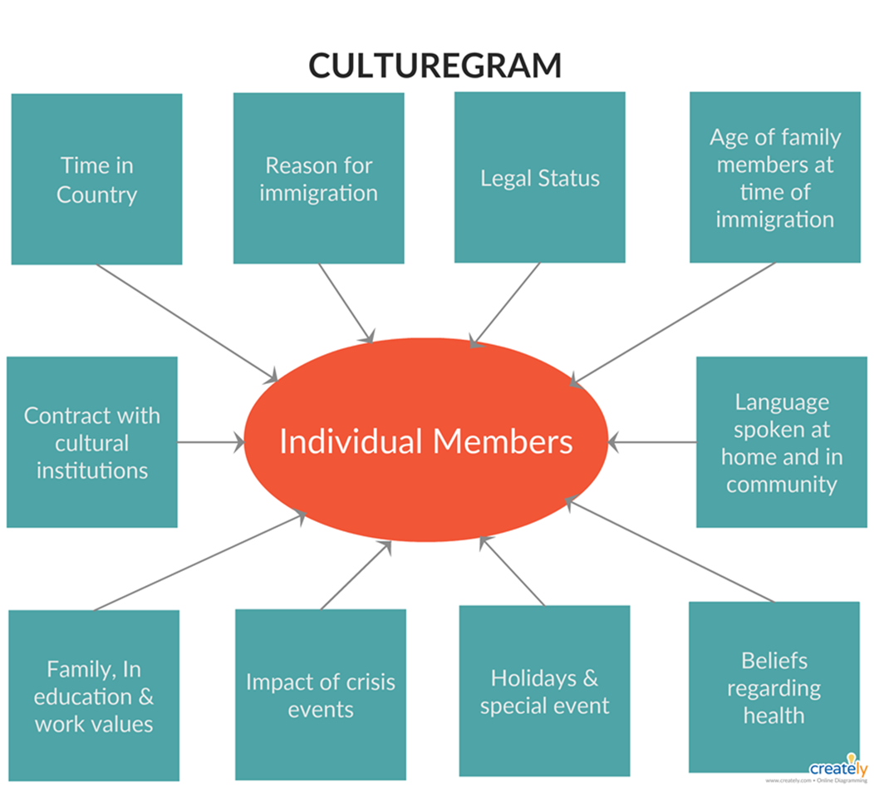
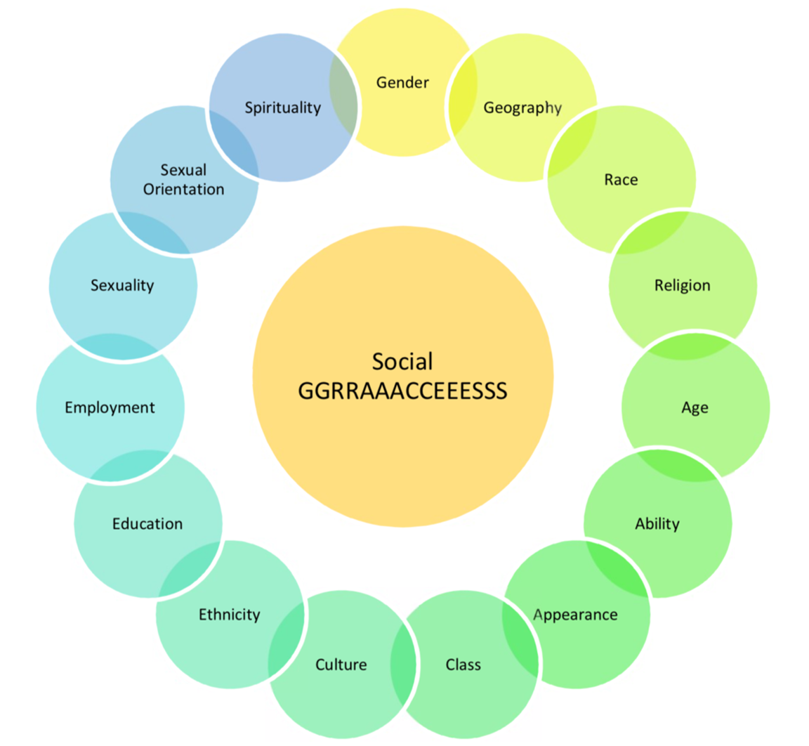
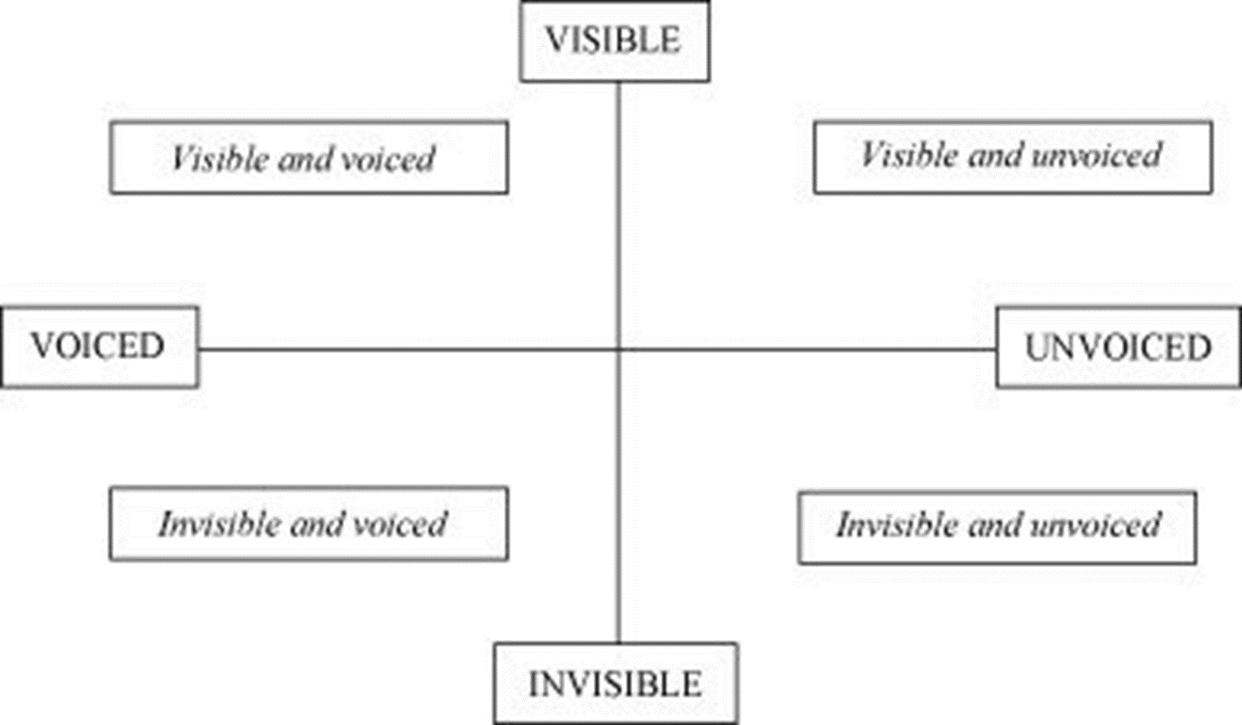
Assumptions:
All aware of tools such as culturagrams, social graces, Mandela Model, amongst other
What were the benefits and challenges?
How can it change your practice?
Notes:
H

Slide 19
THE THEORETICAL BASE & CULTURAL BASE FOR OUR PRACTICE
List of current theories used
Problem with many tools but looking at the ACE as an example: https://www.theannainstitute.org/Finding%20Your%20ACE%20Score.pdf
Case study Republic of Babetikosweti
Moral relativism
Some ethical challenges and problems facing Professionals are specific to particular countries; others are common (IFSW, 2004)
Often work with people who are culturally different and who hold different values.
How do we take this into consideration when working with people, and should we?
Do we have right to impose British values on persons we work with?
Is there such a thing as “Global Ethics”?
Do our own morals and values change over time?

Slide 20
What should we do?
Reading lists
Theories specifically from non- global north countries.
Ncube’s tree of life
Application of these ideas
Using these ideas as reflective tools
Making national and international links
Cultural humility

Slide 21
Cultural humility
O’Niel (1990)
Sit down, ask listen
Learn directly from the people
Developed in America in the field of health to help professionals deliver culturally appropriate medical care.
Centred on self-reflection and learning from the client, seen as a lifelong process and can’t be reduced to competencies
Mutually beneficial to client and professional
Emphasises self-critique and respect between practitioner and service users
Practitioners are culturally humble in their practice with service users/carers
Intrapersonal dimension: practitioners recognise and accept their limitations in understanding service users world view and cultural background
Interpersonal dimension: practitioners show respect and openness to the service users world view
(Weich & Obase, 2019)
Notes:
C

Slide 22
Cultural humility
Are you a racist?
Notes:
C

Slide 23
Cultural humility
Sit down, ask and listen
Strengths:
Moves practitioners beyond tolerating difference to developing empowerment
Practitioners that adopt a learning mode in relation to culture can shed some of the power and control inherent in the service user/practitioner relationship
Encourages service users and communities to share past and current experiences and interpretations which helps practitioner learn
Helps practitioners learn about both personal and cultural identities of service users.
Cultural humility helps strengthen the working relationship
Notes:
C

Slide 24
Cultural humility
Challenges:
Social workers need to rely on the power in the relationship at times.
It can be difficult when the world view of the client conflicts with social worker’s personal values
It can be difficult when the world view of the client conflicts with social workers’ professional values
Need to move past ‘tolerating difference’
No real established framework in terms of practical working
Notes:
C

Slide 25
Understanding the process of fitting in: Acculturation

Slide 26
Culture:
Culture is to society what memory is to the person. It specifies designs for living that have proven effective in the past, ways of dealing with social situations, and ways of thinking about the self and social behaviour that have been reinforced in the past. It includes systems of symbols that facilitate interaction: the rules of the game of life that have been shown to “work” in the past…
(Triandis, 1989: 511-512)
If the above is true, what is the effect of removing a person from his or her culture or moving to another culture?
What effect will this have on the work we do with asylum seekers?
Notes:
3m

Slide 27
Values, Norms & customs
Values?
In UK, problem: do not know what importance to attach to culture, process of acculturation very important
Acculturation: “ ....acculturation is the natural process of adaptation of an individual who has been socialized in one culture and moves to another culture. This adaptation process does not forego ties with the original culture. This adaptation process not only makes the individual more effective in the new culture, but also brings aspects of the old culture into the new and changing it as well.” (Wichert, 2000)
Notes:
5m Explain the process of acculturation and the process of adjusting to the local culture, the ups and downs.
Focus on the impact on the family and what will happen to the family relationships in this time.

Slide 28
ACCULTURATION
Wow
When we
We got
We had
Emotions
Time

Slide 29
Norms & customs
Value of culture & position of client in process of acculturation to be considered
Many times problems are experienced by clients due to different views on Child rearing; acceptable values & norms, etc..
https://www.youtube.com/watch?v=u-YgKtSzdlM (2:38 >)
How we solve problems….
Notes:
3m

Slide 30
Method of problem solving
Western modes >individualistic perspective. > Task Centred; Crisis Intervention; RET, Transactional analysis, etc..
Many other cultures, problems not solved individually, but communally.
A person is a person through other people. UBUNTU
Advantage of using family/ community in solving problems: >> Reflexivity.
Different legal systems in solving problems in community: Accusatory Vs. inquisitorial legal systems. Many traditional legal systems: focus on restoration, not on finding guilty party.
Liberian amputees
Notes:
5

Slide 31
VIEW OF THE SELF: Collective and Individualistic consciousness
Very difficult to explain or understand collective consciousness from an individualistic consciousness, or vice versa.
Collective consciousness not only linked to race, but more importantly to deprivation and poverty.
Children learn at young age that no one adult can provide in all your needs, even survival as single family is very difficult.
Notes:
4

Slide 32
Manifestations of collective consciousness (cc)
People in cc are socially open, people in individualistic consciousness(ic) are socially closed. Speak with soft voices in public
People with cc are closed in inter – individual (private) situations, people in with ic are open in inter-individual consciousness are open in inter individual private situations>> Affluent men (ic)>> show emotions to wife in public, man from dis-empowered community(cc) > less emotions.
Communities in cc have collective democracy, people in ic communities have ic > decision making/ political systems
Time> Not important, viewed differently in cc.
Work ethics

Slide 33
In summary…

Slide 34
A practical couple of questions to consider
Reminder
Karreem & Littlewood (1992, 2003):
What is a White Social worker’s knowledge of specific culture?
What is the relationship between social worker and various members of family?
If children are involved, what is your knowledge of the developmental stages in this community?
How conscious are you of needs of all members involved?
Did you allow yourself to be influenced by own cultural background?
How judgmental were you in your approach?
How realistic are your fears of further problems/
What is the true motives of the client?
Did you explore the clients understanding of the situation further?
What is the legal position?
Are there any conflicting rights?

Slide 35
Practising differently
Using a wider range of theories
Creating opportunities to link both locally and internationally
Moving to true systemic work: making use of resources other than what the policy dictates, look at the community > Community profiles
Being open to learn from communities, they are the experts. Sit down, ask and listen Also..
Learn from the student community
Allow students from abroad a safe space to learn, a safe space to explore their ideas
Think about their culturegram, social graces and process of acculturation.
What you say and what you mean is not always what students whose first language is not English hear or understand.
Encourage students to become involved in local charities/ voluntary organisations
Be willing to include the family and things like religious and community organisations in your practice.

