Slide 1
Improving the transition between education to employment for new social workers: European perspectives, concerns, and recommendations
IFSW Europe New Social Workers Project
NOPT Conference Keynote Presentation, 2023
Omar Mohamed, Director of the IFSW Europe New Social Workers Project
New Social Workers Project Group (various members, on an upcoming slide)
Project email address: youngsocialworkers@ifsw.org
Notes:
OM

Slide 2
Approach today
A decolonised approach to a keynote
We believe everyone’s voice matters
We value and celebrate diversity
We acknowledge imbalances in power dynamics and address these
We are all holders of knowledge and have the right to share this
We can learn from storytelling, narrative enquiry and discussion
Notes:
OM

Slide 3
WHO AM I?
ASYE New Social Worker in a children’s safeguarding team
Person with lived experience of children’s services throughout childhood
Researcher on decolonisation and indigenous knowledge
Lecturer on anti-racism, decolonisation, and social work practice and theory
3 book chapters around anti-racism and decolonisation
Publications around poverty and sexuality issues for social work
Board member for the British Journal of Social Work
Ethics committee member for the What Works Centre for Children’s Social Care
Sibling kinship carer for younger sister
Notes:
OM

Slide 4
TRANSITION FROM EDUCATION TO EMPLOYMENT
Notes:
OM

Slide 5
NEW SOCIAL WORKER
Final year of graduation
First 5 years of employment
Notes:
OM

Slide 6
Current project group
Previous Members
Bulgaria: Ahmed Husham Suidan
Israel: Lina Otallah
Lithuania: Migle Maniusyte
Malta: Gabriel Sciberras
Republic of Moldova: Alina Zagorodniuc
Romania: Adriana Salcianu
Switzerland: Tobias Kindler
Turkey: Celal Yildirim
UK: Nadeen Brown
Current Project Group
Armenia: Tatevik Karapetyan and Mariam Mazmanyan
Austria: Anna Lang
Georgia: Ketevan Lekishvili
Italy: Marta Cherubin
Ireland: Laura Peters
Netherlands: Veerle Meijer
Portugal: Rita Luís and Débora Silva
Romania: Gabriela Petre
Spain: María Pérez Bandera
Notes:
OM

Slide 7
What we have done
Workshops and collaborative meetings between research team to discuss own experiences as new social workers
Creation of quantitative survey that was released in January 2021 and received 783 responses, engaging 31 countries in Europe
Semi-structured interviews with 84 new social workers across Europe
Analysed data as a research team through reflexive thematic analysis
Notes:
OM

Slide 8
Rossita Maclean
Notes:
OM

Slide 9
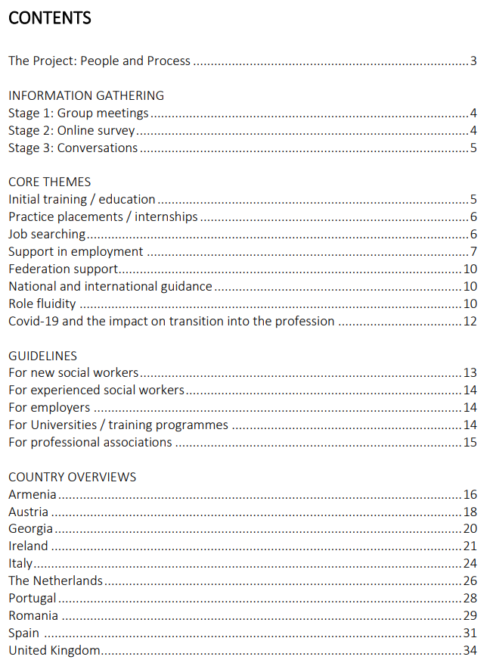
POLICY PAPER SHARED – STRATEGY AND ACADEMIC PAPER BEING REVIEWED
Notes:
OM

Slide 10
ACADEMIC PAPER STRUCTURE
Notes:
OM

Slide 11
CONTEXT
There is interest on studying the transition from university to first employment by researchers globally.
Different methods are used to analyse and compare the characteristics of this transition between European countries.
Some of the studies only focused on one or two European countries.
Our aim → to study new social workers’ own experiences of this transition across Europe comparing both similarities and differences and sharing the voices of many.
Notes:
OM

Slide 12
FUTURE COMPETENCES FOR new SOCIAL WORKERS
Understanding micro and macro level issues
Promoting human relationships
Competency in understanding the role
Engaging with available support
Respect for indigenous knowledges and diversity
Critical thinking
Autonomy
Self-control, self-esteem & confidence
Communication skills
Ethics & values
Working within multidisciplinary groups
Knowledge of theories and practice models
Notes:
OM

Slide 13
Methodology
Collaborative autoethnography design (Ngunjiri, Hernandez, and Chang, 2010; Chang, Ngunjiri and Hernandez, 2013; Hernandez, Chang and Ngunjiri, 2017),
Mixed-methods data collection (quantitative survey and qualitative interviews)
Reflexive thematic analysis (Braun and Clarke, 2017)
Linking in with social work values (IFSW, 2018) and Ubuntu (Truell & Mayaka, 2020)
Notes:
OM

Slide 14
PARTICIPANTS
Country | Research Team | Survey | Interviews
Armenia | 2 | 26 | 18
Austria | 1 | 113 | 2
Belgium | 0 | 1 | 0
Bulgaria | 0 | 1 | 0
Croatia | 0 | 1 | 0
Cyprus | 0 | 1 | 0
Czech Republic | 0 | 1 | 0
Denmark | 0 | 110 | 0
Finland | 0 | 28 | 0
France | 0 | 4 | 0
Georgia | 1 | 22 | 0
Germany | 0 | 25 | 1
Greece | 0 | 22 | 0
Hungary | 0 | 8 | 0
Ireland | 1 | 78 | 9
Israel | 0 | 10 | 0
Italy | 1 | 39 | 20
Kosovo | 0 | 6 | 0
Lithuania | 0 | 22 | 0
Latvia | 0 | 1 | 0
Malta | 0 | 2 | 0
Norway | 0 | 3 | 0
Poland | 0 | 1 | 0
Portugal | 2 | 60 | 22
Romania | 1 | 35 | 6
Slovakia | 0 | 2 | 0
Spain | 1 | 45 | 1
Switzerland | 0 | 2 | 0
The Netherlands | 1 | 41 | 4
Turkey | 0 | 24 | 0
United Kingdom | 1 | 49 | 1
Total | 12 | 783 | 84
Notes:
OM up to 13

Slide 15
FINDINGS Initial training / education
Survey responses
54% of people felt that their training had not prepared them for the profession.
16% of people stated that their initial social work training had prepared them.
30% of people were passive in their response.
Discussions between project group members and the conversation stage
Newly qualified workers feel that their training has not equipped them for their professional role.
Particular concerns
Gap between theory and practice.
Variety in the curriculum across Europe and indeed across particular programmes in the same country.
Notes:
MC

Slide 16
FINDINGS Initial training / education
“Respondents pointed out that what they study at the university theoretically does not actually coincide with practical work.” (Georgia)
“It feels that the work that we do in internships and once we are employed is very different to the courses and assessments at University” (Italy)
“Courses are almost entirely focused on child protection practice with little room for learning in other areas.” (Ireland)
Notes:
MC

Slide 17
FINDINGS Practice placements/internships
Survey
93% of respondents said they had a practice placement or internship as part of their social work training.
Of the 7% of respondents who did not have a placement experience, 68% felt that it should have been part of their education.
Interviews
Students receiving support from a qualified social worker experienced more valuable learning opportunities.
Many people discussed difficult experiences on placement because of:
Lack of learning opportunities where their supervisor was not a social worker.
Significant concerns around discrimination.
Notes:
MC

Slide 18
FINDINGS Practice placements/internships
Good support by a qualified social worker/practice educator
Valuing the student/intern
Better learning experiences
“It is not mandatory to have a social worker as a supervisor for internships. This is a problem in terms of what people are learning. Are they really learning to be a social worker?” (Portugal)
Notes:
MC

Slide 19
FINDINGS Practice placements/internships
“It is important that internship organizations pay more attention to the students’ internships and assess exactly what are students’ needs on the one hand, and on the other hand, how should they motivate supervisors to be involved in teaching process. Managers of these organizations should recognize importance of having students in their organizations as they are in fact potential employees for the future, and they can get benefits by offering quality of supervised internship places for them...” (Georgia)
Notes:
MC

Slide 20
FINDINGS Practice placements/internships
Many new social workers gave insight into the importance of asking questions to experienced colleagues and the barriers to this. Experiences were shared around a lack of confidence to ask questions and to be able to reflect with the supervisor during the practice placement or internship. Also, time constraints where the supervisor and new social worker are busy due to the intensity of the job, insecurity of the students, and a lack of supervisor/supervisee relationship can make it difficult to ask questions confidently.
Notes:
MC

Slide 21
FINDINGS Practice placements/internships
“A curricular internship should not be seen as adding a fully operational human resource to the organization, the focus in curricular internships should always be on learning and both institution and faculty should have responsibility for this role.” (Portugal)
Payment or subsidiary financing of practice placements of internships to enable the new social worker to live and fund their basic necessities was mentioned as a dire need.
Notes:
MC

Slide 22
FINDINGS Job searching
Difficulties:
Organisations largely offering short term contracts to new social workers
Employers requiring experience in the role, which is difficult, if not impossible, to obtain
Discrimination in job finding based on age, disability and gender
In some countries new workers feel tempted into poorly paid jobs in order to gain experience.
Notes:
MC

Slide 23
FINDINGS Support in employment
Notes:
MC

Slide 24
FINDINGS Support in employment
Intervision
“Intervision is vital. Reflecting on one's own actions and uncertainties must be able to be addressed in a protected setting for further development” (Austria)
Peer support
“Where there is a qualified social worker in the workplace then employment support is much better.” (Armenia)
Supervision
“There is a need for more emotionally supportive supervision” (Italy)
Further training
“… not many trainings and webinars are conducted in the field of social work. At this stage, in addition to university education in Georgia, webinars and rarely trainings are offered by the Georgian Association of Social Workers only, which is not enough actually, but there is a real need.” (Georgia)
Caseload or workload reduction
“Do not start with a full caseload at the beginning!! If not, people are leaving after one year.” (Netherlands)
Notes:
MC

Slide 25
FINDINGS Support in employment
A formal induction
“There should be an integration process inside the institution upon the arrival of the new professional, in order to explain his/her role and functions.” (Portugal)
Shadowing and mentoring
“In general, I find the principle of a buddy or mentor very helpful and positive. But I think it depends on how it's done, and of course it's also a bit of luck how well they get along.” (Austria)
Coaching
“It would be helpful to practice with a job coach to see what kind of qualities someone possesses besides the regular social work diploma (…) it leads to social workers speaking up for what they think are good ideas, instead of sticking to the education curriculum or to processes that are actually outdated.” (Netherlands)
Opportunities for reflection and reflexivity
“Opportunities to reflect and getting to know myself as an individual really helped me.” (The Netherlands)
Notes:
MC

Slide 26
FINDINGS Federation support and national and international guidance
“I only know the student association, haha. We heard about it during my work now (never during studies), but never felt like it was needed, or I should invest.” (Netherlands)
“There is not enough information about the role of the college of social workers, its functions and its ideas for the profession.” (Italy)
“Annual fees are high, and you don’t know where the money is spent.” (Anonymous)
Notes:
MC

Slide 27
FINDINGS COVID-19 impact on transition
Positives
• There were more job opportunities in some countries
• The increase in online working mean that it has been easier for new workers to engage more with the activities of their associations
• There has been more training available through online platforms
Negatives
• Online working has left new social workers feeling more isolated
• There has been a lack of opportunity to learn from what is happening around you in a busy office since people have been mostly working from home or have been socially distanced in workplaces
• The current work role is very different to the role learnt about at University
• Many students did not have the opportunity to attend a formal graduation ceremony, this gave a lack of sense of ‘transition’
Notes:
MC
from 14 to 26 - Marta

Slide 28
GUIDELINES FOR NEW social workers
Whilst support for new social workers is vitally important, the new social worker is not a passive recipient of this support. They have responsibility to:
Ensure that they find out what support is available and make best use of this
Critically evaluate the support available and ask for what they need
Ask questions to ensure they understand what is expected of them
Engage with peer support
Engage with the activities of their professional association
Share their new ideas, theories, models etc with more experienced workers in the organisation
Notes:
TK - Tatevik (up to 31)

Slide 29
GUIDELINES FOR Experienced social workers
Responsibilities to support transition into employment do not lie only with new social workers and their employers. The project highlighted how much influence existing social workers had on the experiences of those entering the profession. Experienced social workers should therefore:
Reflect on what it was like to be at the start of social work career
Remember that experience is valuable in training new social workers
Be available for new social workers
Recognise and value what they bring to profession
Recognise and value that sometimes it is difficult to ask questions
Demand that new social workers are better supported
Act as a guiding mentor
Make links with local training providers and offer training support to new social workers
Notes:
TK

Slide 30
GUIDELINEs FOR EMPLOYERS
Organisations which employ social workers should:
Recognise that new social workers bring a great deal to an organisation
Ensure that new social workers are comfortable to ask questions
Set up buddy systems – these are supportive for all workers not just those who are new to the profession
Assess each new social worker’s individual needs and ensure that they have appropriate support and opportunities
Support new social workers in developing skills in areas they are interested in
Facilitate relationship development between new and experienced social workers – promoting mentoring
Provide an induction and time for new social workers to settle into the organisation
Ensure that good quality reflective, emotionally supportive supervision is provided to all social workers within the organisation
Seek to make links with local universities and training providers to offer placements and internships
Notes:
TK

Slide 31
GUIDELINEs FOR Universities/TRAINING PROVIDERS
All those involved in the initial training of social workers should:
Ensure that the quality of practice placements and internships is carefully monitored to ensure that students are receiving the opportunities and support they require
Seek feedback from students and organisations
Carefully consider how they can support students to link theory with practice more clearly
Provide more practice orientated experiences in the education institution. This might include, for example, practitioners and people who use social work services doing guest lectures; role plays with feedback; the use of simulated practice environments
Provide reflective spaces for students and enable new graduates to continue to connect with these reflective spaces
Offer support for soon-to-be graduates and graduates to prepare for job searching and entering employment. There should be a named specialist who can offer careers guidance and support
Notes:
TK

Slide 32
GUIDELINES FOR ASSOCIATIONS
Professional Associations could draw widely on the findings of this project. Group members feel that professional associations should:
Involve new social workers more
Lower membership fees for new social workers
Offer support in job searching
Support mentoring relationships
Deliver training
Consider intervision for new social workers
Provide new social workers with reflective spaces and tools
*Engage with new social workers in own country to discuss and review the strategy and academic papers and consider the development of further country specific guidance where appropriate*
Notes:
TK

Slide 33
Thank you for listening please ask questions!
More info: https://www.ifsw.org/update-on-ifsw-europe-new-social-workers-project-youtube-video-and-monthly-international-exchange-webinars/
Omar Mohamed – omarmohamedsw@outlook.com – Twitter: @OmarMohamedSW
New Social Workers Project Group
Project email address: youngsocialworkers@ifsw.org
Notes:
OM, MC, TK

