Slide 1
Our approach to social work education and training
Jonathan Monk
11th July 2023

Slide 2
Purpose of the session:
To outline the development of our approach to Social Work Education and Training
To provide an update from our Education Quality Assurance programme

Slide 3
Prevention and Impact
Objective 1: Build trust and confidence in the social work profession, and in regulation, by strengthening our relationship with the sector
Objective 2: Share the data and insight we hold about the social work profession and our regulation. This will help us to support leaders and policy makers to drive change, and ensure our processes are safe and fair
Objective 3: Collaborate with other sector leaders to develop a clear and shared understanding of risks to the public and agree how to manage those risks
Objective 4: Ensure all social work students receive comprehensive and consistent education and training, in a supportive and inclusive learning environment to prepare them for practice

Slide 4
Our new approach to social work education and training
Published in June 2022
Sets out seven areas of focus for activity across the next three - year cycle and beyond:
Equality, diversity and inclusion
Readiness for practice
Practice education
Standards and guidance
Educators and practice experience
Student registration
Newly qualified social workers

Slide 5
Key Developments and Influences
Internal | External
Ongoing development of new guidance on ‘Readiness for Professional Practice’ and our knowledge, skills and behaviour statements. | The Department for Education’s ongoing work in relation to the reform of children’s social care, including development of an Early Career Framework.
Research into models of practice education and the role of practice educators. | Introduction of Level 7 (postgraduate) Social Work Degree Apprenticeships.
Establishment of the Education and Training Advisory Forum to support our work. | Reform of student finance and the phased introduction of lifelong loan entitlement.
Development of our ‘Education Strategy Roadmap’ which will set out our timelines and work over the next business year and across our corporate cycle. | Changes in relation to the bodies responsible for the quality assurance and regulation of higher education.
Development, consultation and implementation of standards for Best Interest Assessor programmes and inspection of Approved Mental Health Professional courses | Decision to delay Mental Capacity Act reform and the introduction of Liberty Protection Safeguards
Learning from the first two years of regulation of initial education and training programmes to develop our understanding and provide the evidence base | Practice Education – Call to Action from Teaching Partnerships

Slide 6
Social Work Education and Training Advisory Forum
Social work education stakeholders engage and act as a critical friend to Social Work England on the implementation of our approach to social work education and training
The forum has focused on supporting the implementation of the readiness for professional practice guidance, based upon the findings from our recent consultation
Membership includes individuals with lived and learned experience of social work; organisations with a strategic interest in pre-registration social work education in England; individuals with broad experience and an expert knowledge of social work education in England
Developing approaches to student representation and engagement with practice educators

Slide 7
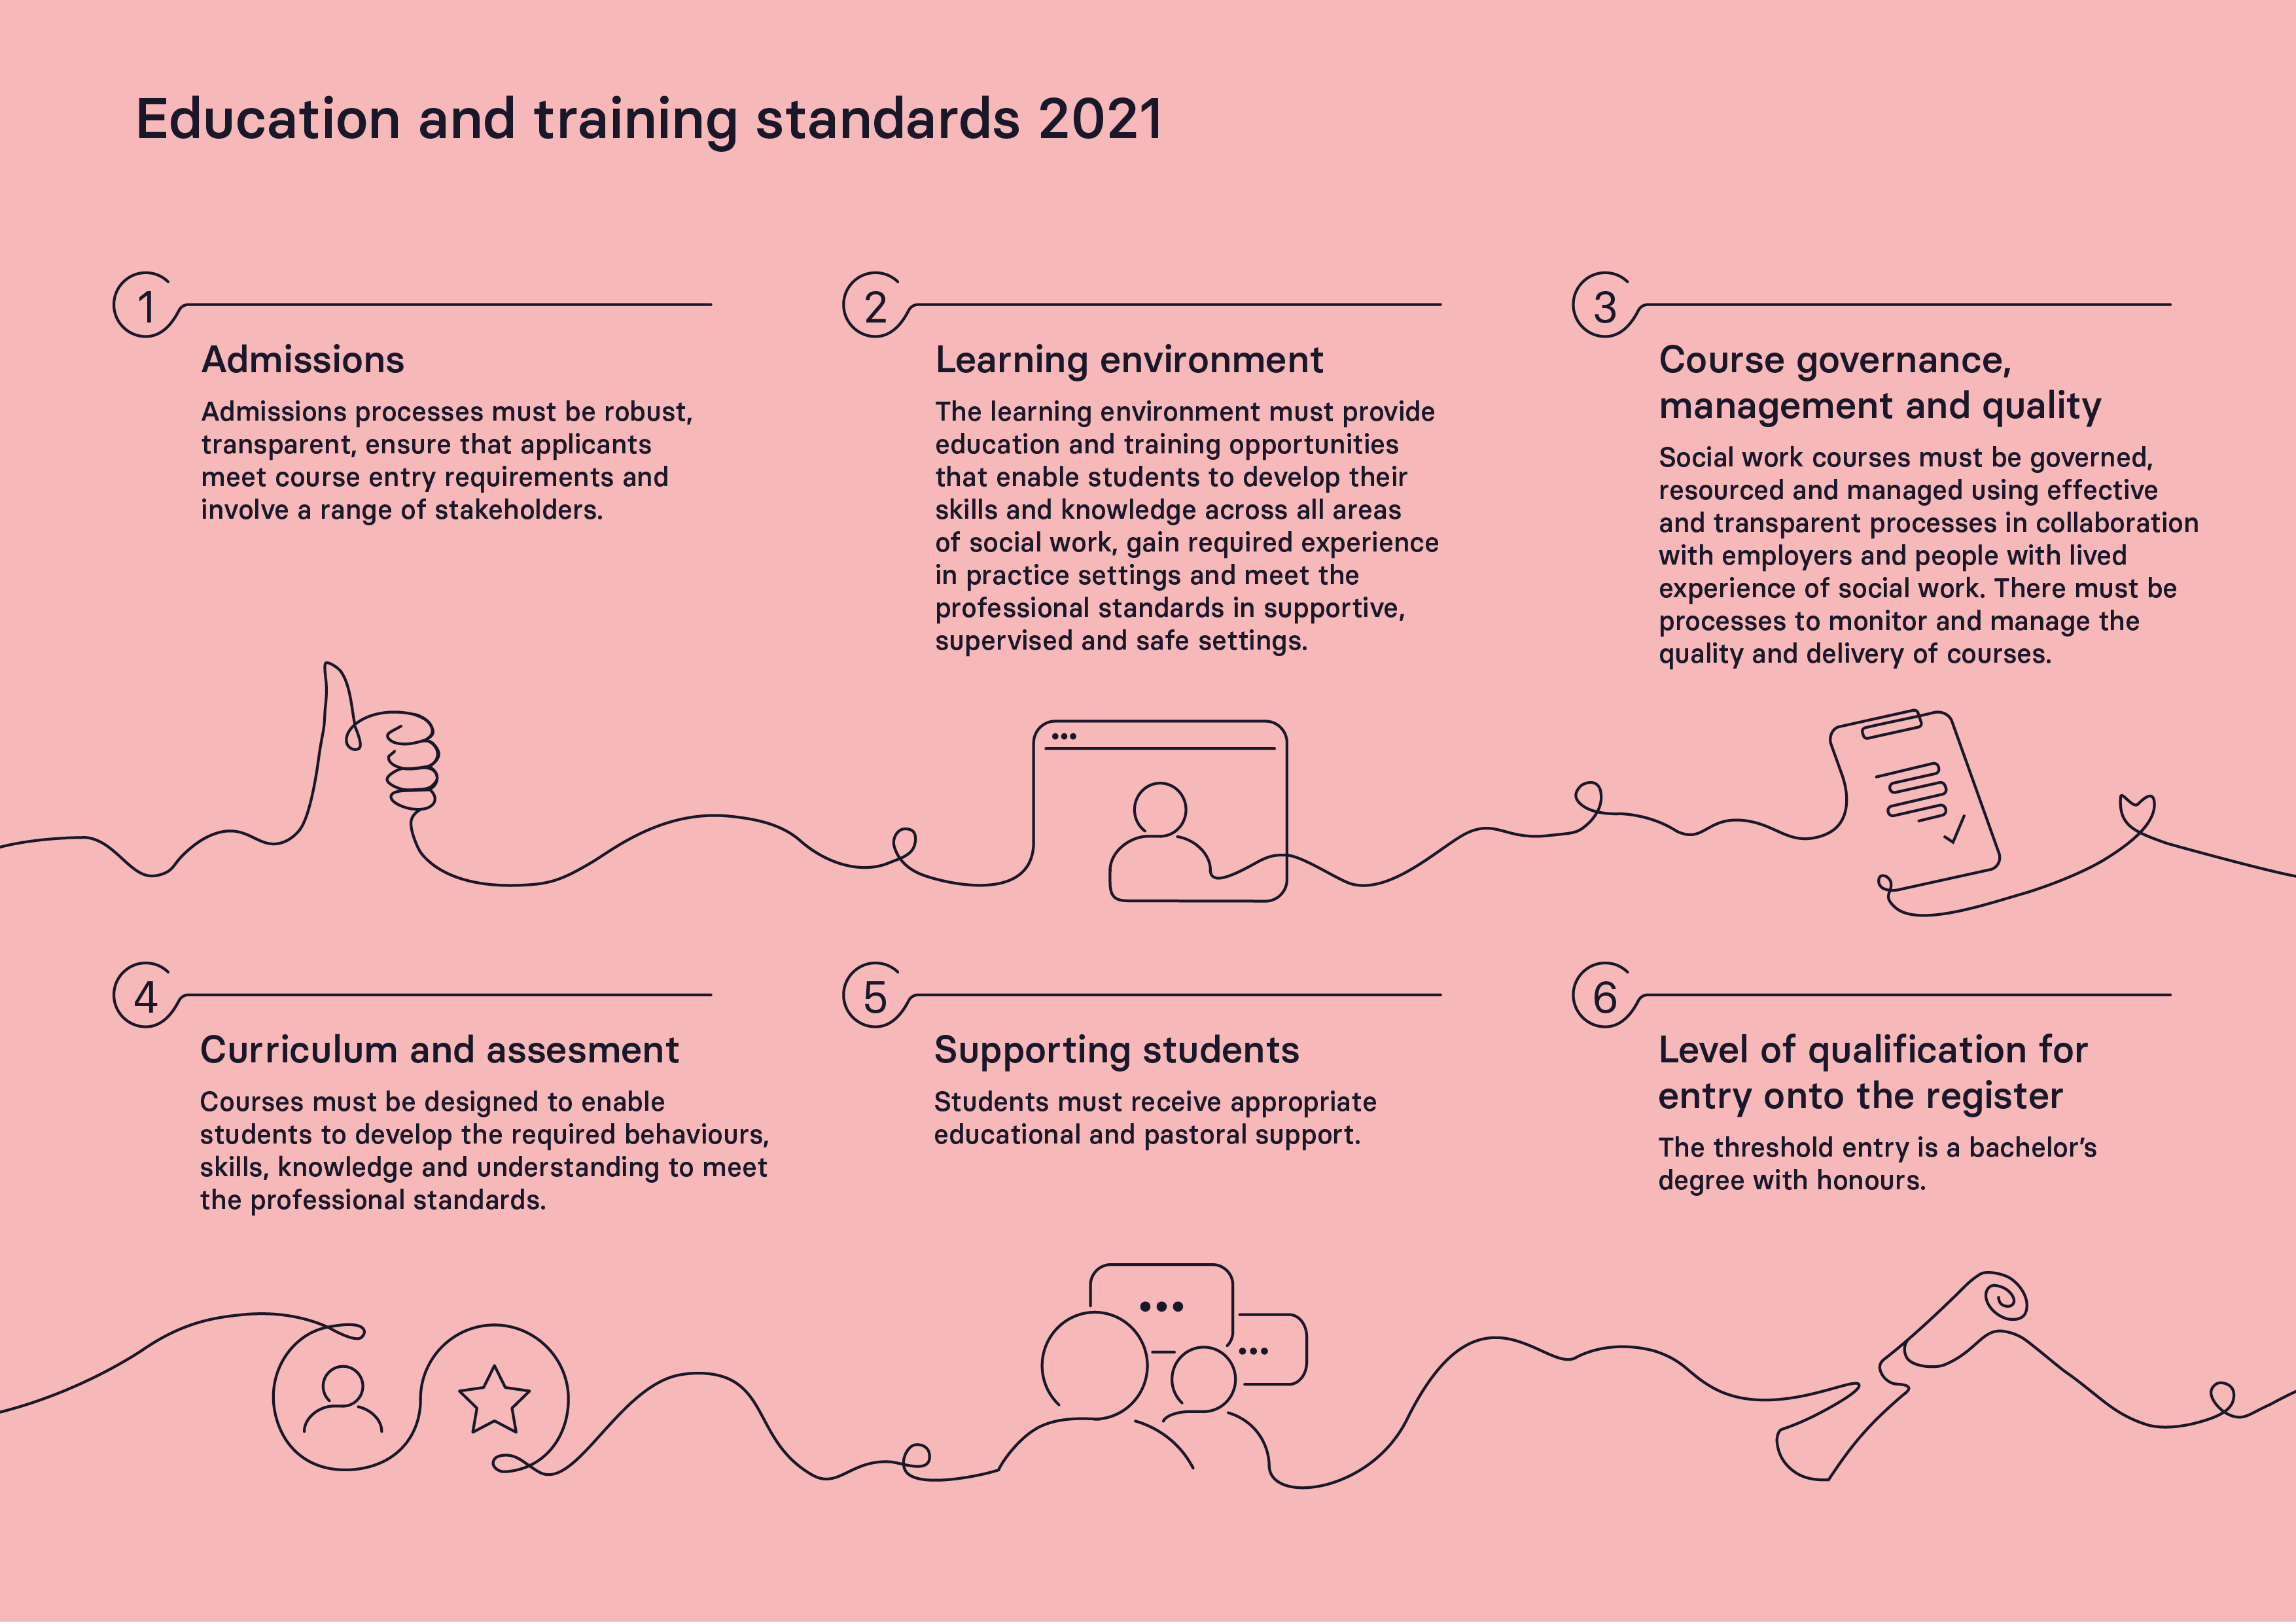

Slide 8
Education Quality Assurance
Inspections against our Education and Training Standards to approve or re-approve courses of initial education
Mid-way through year two (Sept 22 – August 23) of a three-year programme of inspections
Head of Education Programmes recruited
Undertaken annual monitoring of social work courses – mandatory declarations and voluntary thematic questions
226 courses approved or reapproved in years one and two – over 89 inspections
Year three schedule includes 45 reapproval inspections and 3 approval inspections, covering 98 courses
Working with 57 Inspector Partners – development, training, appraisal and learning from feedback
Enquiries and concerns processes
End to end process review – to learn from first two years of inspections and ensure that our processes are efficient, effective and robust

Slide 9
Our approach to Education Quality Assurance: Approval and Reapproval Process
Request
Inspector review
Inspection three days onsite or remote
Report
Regulator decision
Pre-inspection
Up to 6 days of inspector time
Annual Monitoring
Notes:
Hannah: Overview of process
Transition from HCPC
Explanation of timescales – inspector days and intentions
Highlight process is covered in detail in Workshop 4
Cover work in progress and concerns – annual monitoring

Slide 10
Our next steps over the coming year
Education Strategy and roadmap
Findings from our research projects
Analyse findings from our regulation of initial education and training to develop our position and understanding
Annual Monitoring – sharing learning
Implementation of Best Interest Assessor Standards and approach to inspection
Engagement with course providers, practice educators and students to develop insight
Digital developments
Review existing education and training standards – learning from current cycle and lessons for planning next cycle
Providing leadership and direction within a complex landscape
Making positive improvements to equality, diversity and inclusion in social work education and training

