Slide 1
NATIONAL ASSOCIATION OF PRACTICE TEACHERS CONFERENCE
Practice Educator Professional Standards – Reviewing and Evidencing the Standards
Sarah Brown, Reader in Social Work, University of Kent
Polly Sykes, Lecturer, Director of Practice Learning, University of York
July 11th 2023

Slide 2
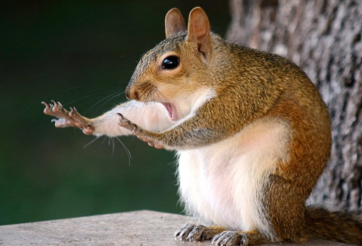
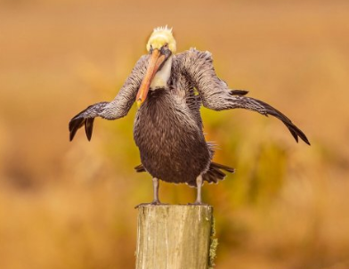
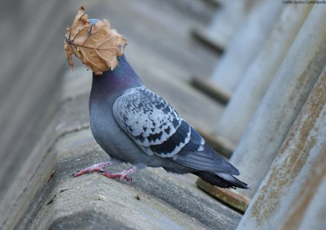
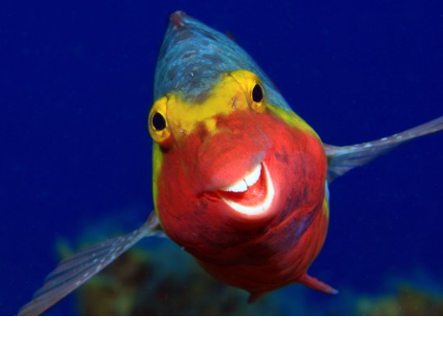
PEPS Refresh 2022 - how do you feel?
Notes:
10 mins
Picture 1: ‘Caught in the Act’ by Mary McGowan
Picture 2: ‘Shaking off 2020’ by Dawn Wilson
Picture 3: ‘I guess summers over’ by John Spiers
Picture 4: ‘We’re too sexy for this beach’ by Joshua Galicky
Picture 5: Romantic by Valtteri Mulkahainen
Picture 6: Smiley by Arthur Telle Thiemenn

Slide 3
OVERVIEW OF SESSION
Context and purpose of the PEPS Refresh
Key outcomes of the ‘refresh’
Implementation and next Steps

Slide 4
Context: The Journey to PEPS Refresh (refreshed!)
The PEPS were initially developed by the College of Social Work
However, in 2015 when the College closed no one took responsibility of PEPS
In July 2017 a survey of stakeholders was undertaken by the PEPS refresh group in BASW England. Overall the results showed support for PEPS values and domains but variation in the quality of PE and the support given to Practice Educators. The PEPS guidance was published in 2019 and updated in 2020
In 2022 BASW further commissioned to undertake a stakeholder review to respond to FAQ and embed anti-oppressive and anti-racist practice into the guidance.

Slide 5
CONTEXT: NEED FOR INCLUSION
Nationally, there is an ‘attainment gap’ in Social Work for minority ethnic students. Anecdotally, at a local level:
More difficult to find placements
More likely to have concerns raised about their progress on placement
More likely to require action plans and
More likely to fail a placement
Devenney et al. 2021
Evidence suggests other ‘protected characteristics’ experience similar patterns.
Notes:
The challenge of finding stats to back up the anecdotes – which also makes it more difficult to work out what is going on.
Anecdotally – particularly difficult if student
Intersectionality / has an additional protected characteristic (such as a disability)
English is not the first language
Not a driver (which tends to mean lower socio-economic groups – already disadvantaged)

Slide 6
Context: Experience
Students worried about how they will be received “Am I gonna be...not welcome. I wonder what people’s attitudes are going to be like” (student from an asian background in an all-white team)
Students’ lived experiences of placement ‘ I was sitting in my car crying’ because I felt so excluded from the team which was all white.
PE’s unsure about how to approach diversity “I think in the past we have pretended that it isn’t an issue and we are colour-blind, and actually what we know is that that isn’t helpful, we actually need to talk about difference.”
Community responses “We know there is racism out within the community and…it’s fair to say the student will encounter it” (PE)

Slide 7
NATIONAL ENGAGEMENT PROCESS
Initial Scoping Review
PWLE
Students
Employers
Independent PE’s
HEI
Learning providers
Stakeholder meetings x 3
PWLE
Students
Employers
Independent PE’s
HEI
Learning providers
Working group for drafts
HEI
Independent PE
PWLE
Employer (invited)

Slide 8
KEY OUTCOME 1: Clarity of process and roles
Clarity of roles and responsibilities: PEPS Trainee, Learner, Assessor and Mentor.
Updated glossary and abbreviations
Clearer guidance on stage of learning and when/who can make decisions about student/learner performance.
Clearer expectations around programme content and evidencing the Domains
Outline of responsibilities in ensuring support and ongoing currency
Links to SWE Professional Standards and CPD

Slide 9
KEY OUTCOME 2: INFORMED BY VALUES
Clearer links to our position on anti-oppressive and anti-racist practice.
Integration and mapping of the values statements
Integration of the updated Code of Ethics
Informed by partnership working

Slide 10
SLIDO.COM #
What is value-informed practice education?
How are people with lived experiences contributing to practice education and assessment?
What theories and models can support value-informed practice education
Notes:
10 mins
What can be transferred directly form SW practice/values, and what is different?

Slide 11
PEPS: Implementation
Please choose a Domain in your group.
Outline ways in which this can be implemented and assessed in a value driven-way.
Do you have any examples/resources to share?
Notes:
20 mins
10 mins feedback

Slide 12
PEPS: NEXT STEPS
What do you see in the future for Practice Education?
What do you need and from whom to implement the PEPS? Think about the following people/organisations:
BASW
Employer
Placement providers
Higher Education Institution
Social Work England
Do you have any resources to share for practice education? Please email polly.sykes@york.ac.uk

