Slide 1
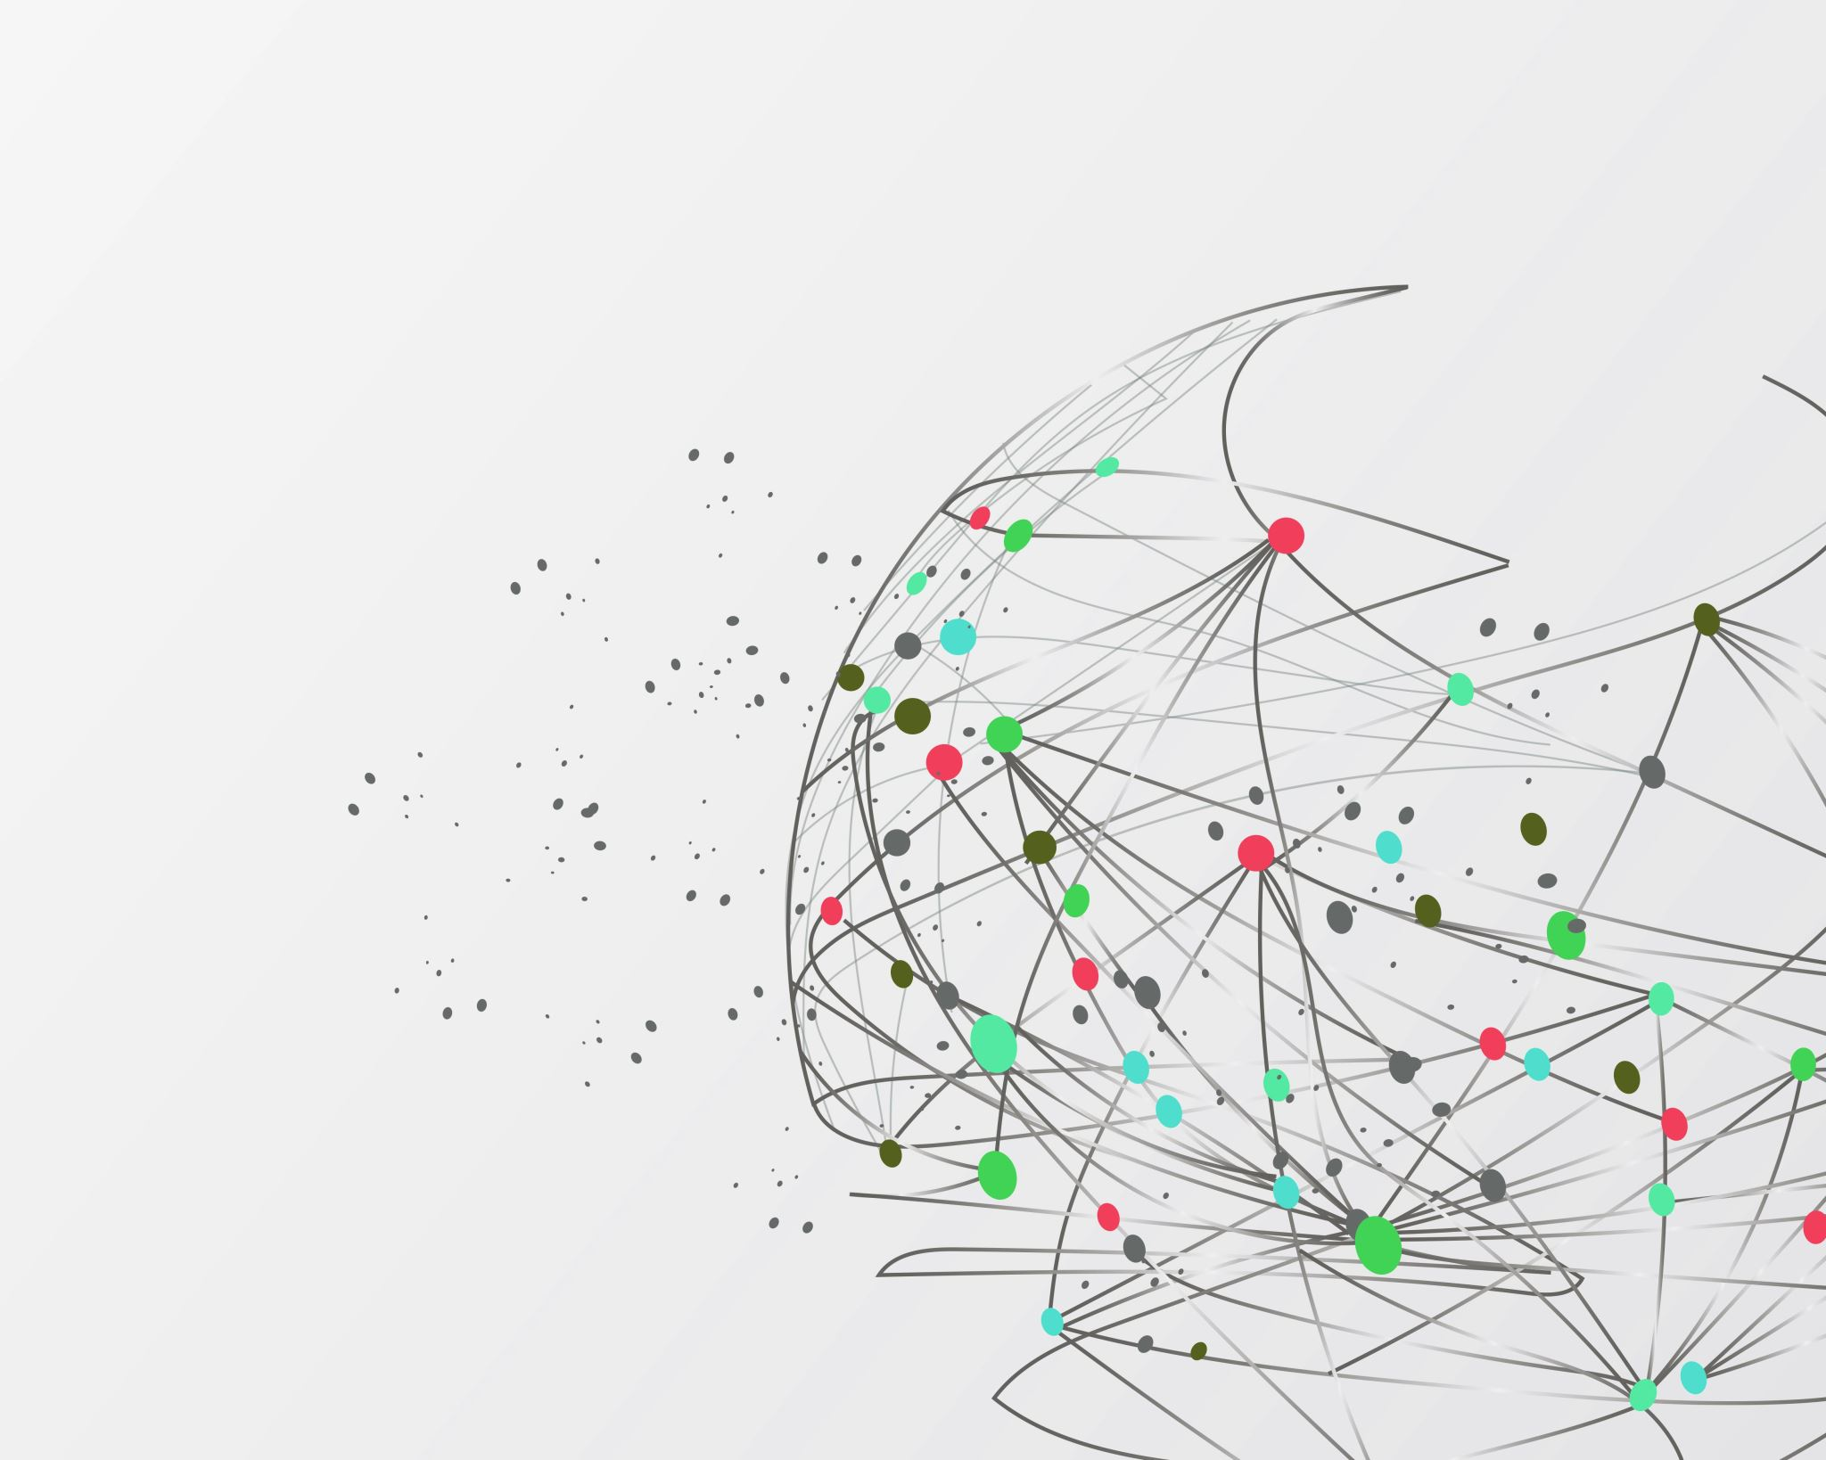
A Holistic Framework of Resilience for Social Workers NOPT Conference June 2025
Dr Sarah Rose, Lecturer in Social Work, Edinburgh Napier University
s.rose@napier.ac.uk

Slide 2
Resilience is
“an empty word that can be filled with almost any meaning.”
(Van Breda, 2018, p.2)

Slide 3
Concepts of Resilience
Coping with adversity.
Maintaining emotional equilibrium (Bonanno, 2004).
Bouncing back – recovering after a short-lived downturn (Fletcher & Sarker, 2013).
Bouncing back and beyond – thriving and flourishing (Youssef & Luthans, 2007).
The ‘psychological immune system’ (Gilbert et al., 1998).
Multi-dimensional.

Slide 4
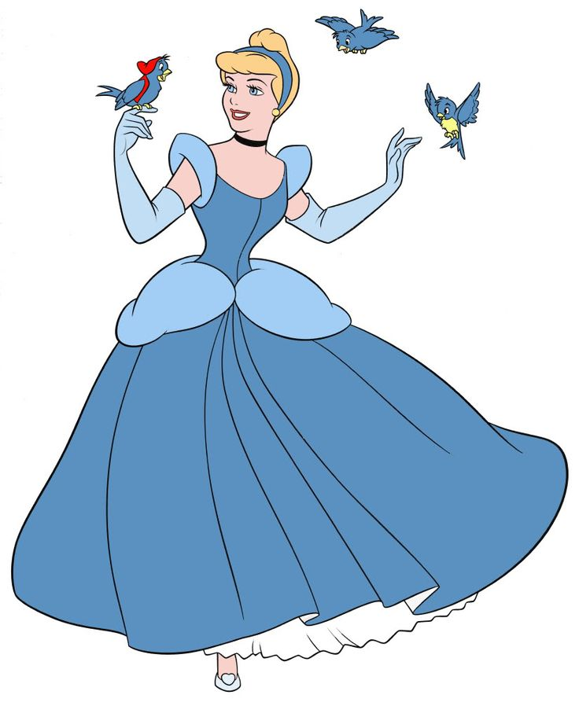
The Resourced Individual
“The problem with Cinderella stories is that they make success seem to be all about the personal qualities of exceptional people. They epitomize the myth of the exceptional individual and conveniently overlook the deficits in the environment that surround their protagonists. The heroes and heroines look so beautiful, talented and self-assured that we forget about the supports that help them escape terrible situations. The story of the resourced individual is hidden in the footnotes.”
(Ungar, 2018, p.16-17)

Slide 5
Ecological and Systems Perspectives
Ecological and systems perspectives recognise the interrelationship between a person and their social environment, taking into account both personal agency and external social structures which may contribute towards adversity, resilience and wellbeing (Ungar, 2018).
Critiques of ‘neoliberalist’ notions of resilience that place responsibility on individuals to manage the impact of social issues (Garrett, 2015; Neocleous, 2013).
Social justice approaches to resilience including activism and collective action (Hart et al., 2016).

Slide 6
Research Methodology
Topic - the resilience of social workers in local authority adult services in Scotland but applicable more broadly.
Interviews with 28 social workers and 8 social work managers / diary entries completed by the social workers.
Social constructionist perspective – exploring how social workers conceptualise resilience in the context of their role.
Creation of a holistic framework of resilience.

Slide 7
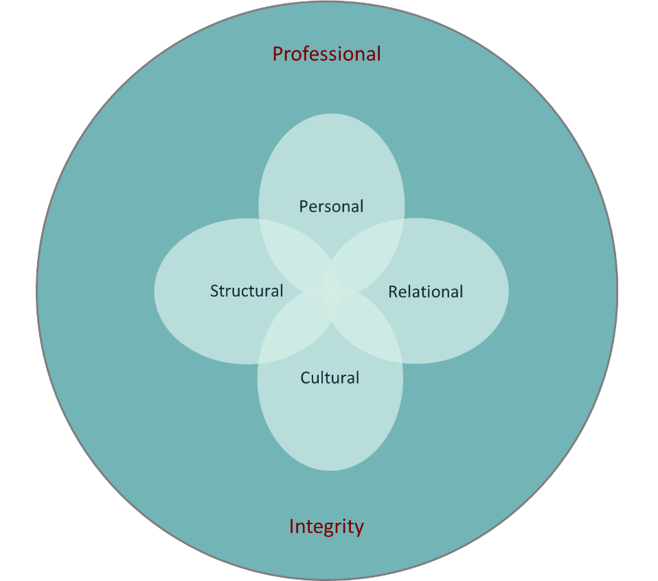
Holistic Framework of Resilience
Adaptation of Thompson’s PCS model of anti-oppressive practice (2021).
PCS - personal, cultural and structural factors.
Additional ‘relational domain’ to reflect the prominence of relationships as a factor in both adversity and resilience.
Importance of professional integrity as a factor underpinning the four domains.

Slide 8
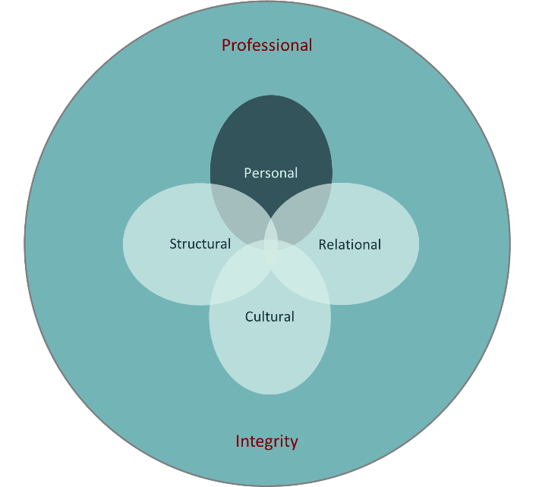
The Personal Domain
Skills and knowledge: Feeling equipped and competent, professional development opportunities, taking on a ‘champion’ role.
Emotional intelligence: Self-awareness and self-management.
Perspective and attitude: Hopeful realism, manageable self-expectation and self-compassion.
Personal and professional self: The interplay between work and home life.
Embodied health: Sleep, nutrition, exercise, mind/body practices such as yoga and meditation.

Slide 9
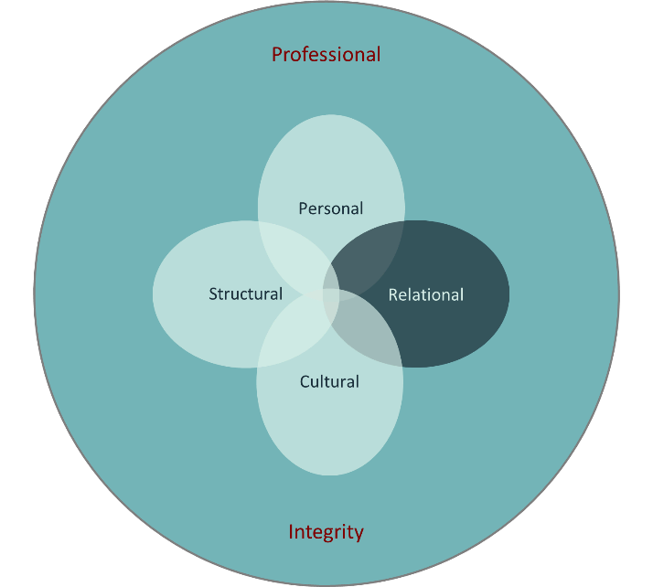
The Relational Domain
Relationships with people receiving services: Job satisfaction, relationship-based practice, empathy, compassion fatigue and vicarious trauma.
Relationships with peers: Mutual support and understanding, friendship and camaraderie.
Relationships with managers: Guidance, supervision, accessibility, trust and blame.
Relationships with multidisciplinary professionals: Collaboration, conflict, role confusion and expectations.

Slide 10
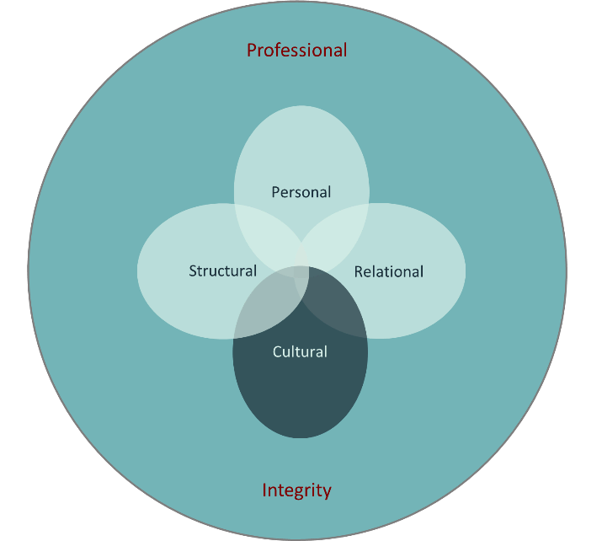
The Cultural Domain
Humans and robots: Moving from managerialism and bureaucracy to a culture of humanity and personalisation.
Creativity and rigidity: Increasing the scope for creative, innovative and responsive practice, sharing accountability and addressing blame cultures.
Emotion and professionalism: Understanding the influence of emotions in decision-making, providing forums for open emotional expression and managing emotional contagion.
Professional identity: Feeling valued and developing a distinct and positive identity for social work.

Slide 11
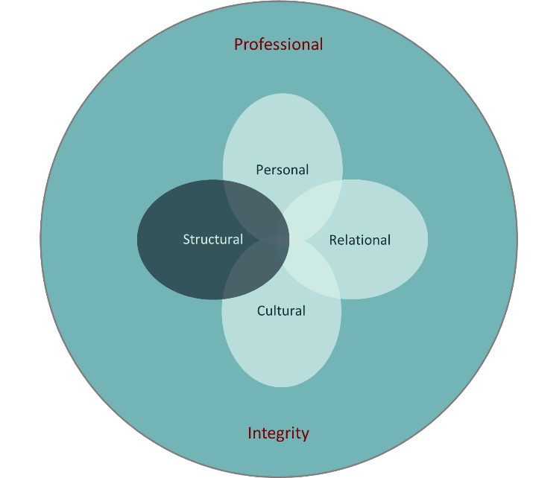
The Structural Domain
Policy, procedure and resources: Streamlining bureaucracy, enacting policies ethically and increasing resources.
Organisational change: Managing and communicating restructure and role change, meaningful consultation with staff.
Workload: Allocation of reasonable workloads with scope for sufficient breaks.
Supervision and guidance: provision of good quality supervision with a trusted person, balancing autonomy and direction.
Wellbeing strategies: Benefits of wellbeing strategies but not as a ‘sticking plaster’ for more fundamental organisational issues.

Slide 12
Resilience and Professional Integrity
Connections between resilience and:
Commitment to effective social work practice in the best interests of people receiving services.
Commitment to a core social work value base.

Slide 13
Any Questions?

Slide 14
References
Bonanno, G. A. (2004) Loss, Trauma, and Human Resilience: Have We Underestimated the Human Capacity to Thrive after Extremely Adverse Events? American Psychologist, 59(1), 20-28.
Fletcher, D. and Sarkar, M. (2013) Psychological Resilience: A Review and Critique of Definitions, Concepts, and Theory. European Psychologist, 18(1), 12-23.
Garrett, P. M. (2015) Questioning Tales of ‘Ordinary Magic’: ‘Resilience’ and Neo-Liberal Reasoning. British Journal of Social Work, 46(7), 1909-1925.
Gilbert, D. T., Pinel, E. C., Wilson, T. D., Blumberg, S. J. and Wheatley, T. P. (1998) Immune Neglect: A Source of Durability Bias in Affective Forecasting. Journal of Personality and Social Psychology, 75(3), 617-638.
Hart, A., Gagnon, E., Eryigit-Madzwamuse, S., Cameron, J., Aranda, A. and Heaver, B. (2016) Uniting Resilience Research and Practice With an Inequalities Approach. Sage Open, 6(4), 1-13.
Neocleous, M. (2013) Resisting Resilience. Radical Philosophy, 178, 2-8.
Thompson, N. (2021) Anti-discriminatory Practice, 7th ed. Bloomsbury Academic.
Ungar, M. (2018) Change Your World. The Science of Resilience and the True Path to Success. Sutherland House.
Youssef, C. M. and Luthans, F. (2007) Positive Organizational Behaviour in the Workplace. The Impact of Hope, Optimism, and Resilience. Journal of Management, 3(5), 774-800.

